Slide 1




Basic Science Class
Fauget Senior High School
ORGANIC WASTE
As An Alternative Energy Source
Group 1 | Presentation

Slide 2

The future is green energy, sustainability, renewable energy.

Slide 3

Introduction
The energy sources we use today are highly disruptive and damaging to the environment, especially due to the use of hydrocarbon fuels that have increasingly caused global warming.
For this reason, alternative energy sources are urgently needed.

Slide 4




The Aims of the Presentation
To deliver a message to understand and think critically about alternative energy efforts
To invite readers to understand how to find and apply alternative energy sources
To inform about the organic waste as one of the alternative energies

Slide 5

Discussion – Alternative Energy
Alternative energy is a term that refers to all usable energy that aims to replace conventional fuels without the unexpected consequences of it.

Slide 6

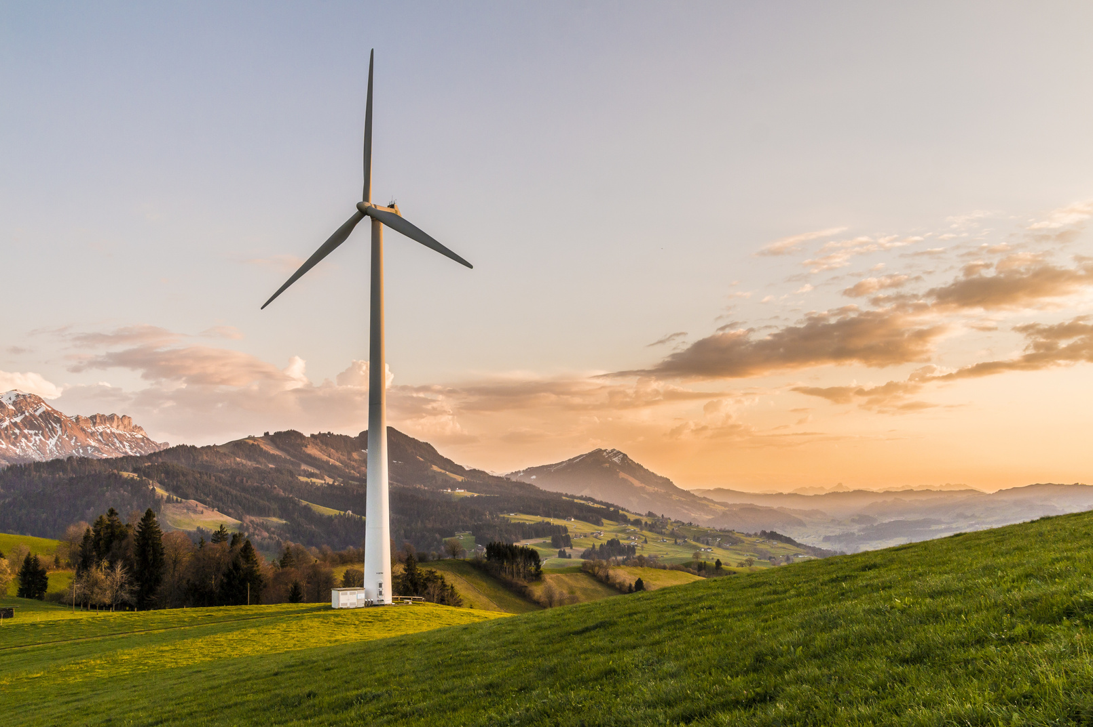
Discussion – Alternative Energy (Cont.)
The term is for the efforts of reducing the use of hydrocarbon fuels resulting in environmental damage due to high carbon dioxide emissions, which contribute greatly to global warming.

Slide 7
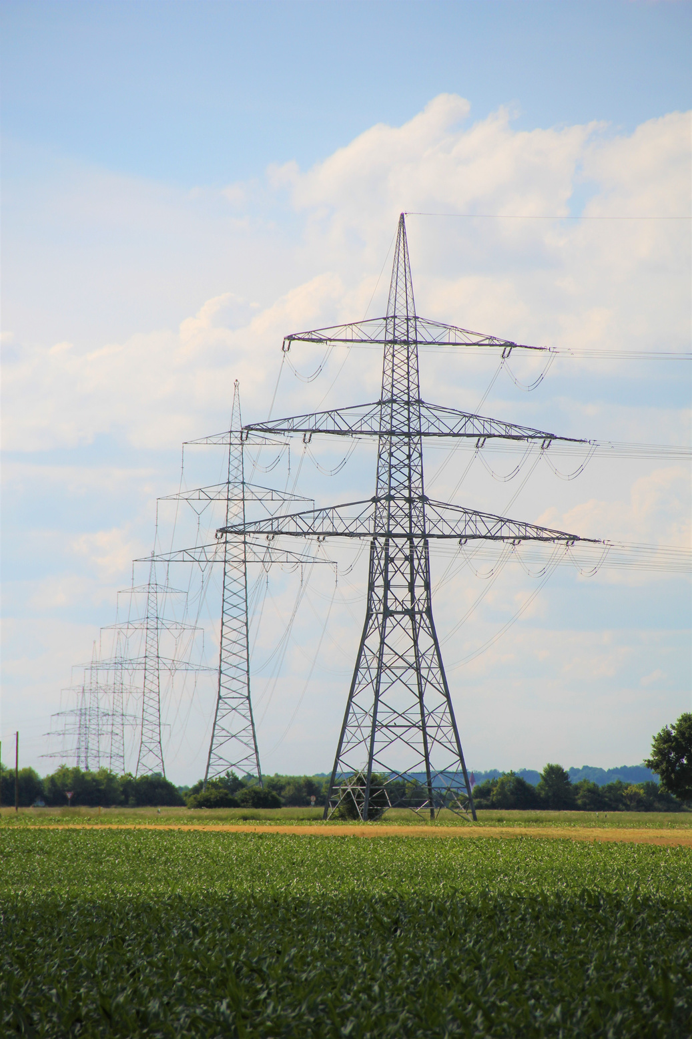
Discussion – Alternative Energy (Cont.)
The term "alternative" refers to a technology other than the technology used in fossil fuels to produce energy.

Slide 8

Discussion – Organic Waste
Organic waste – or biodegradable waste – comes mainly from living organisms, either plants or animals.
Examples include such as:
food waste
human waste
sewage
paper waste
manure
green waste
biodegradable plastic
slaughterhouse waste

Slide 9

Organic Waste as Alternative Energy – Biogas
What you need:
A closed tank or a plastic container or mineral water gallons – to store the garbage (scientifically called a bioreactor)
Then the bioreactor is equipped with a hose to channel the gas produced

Slide 10
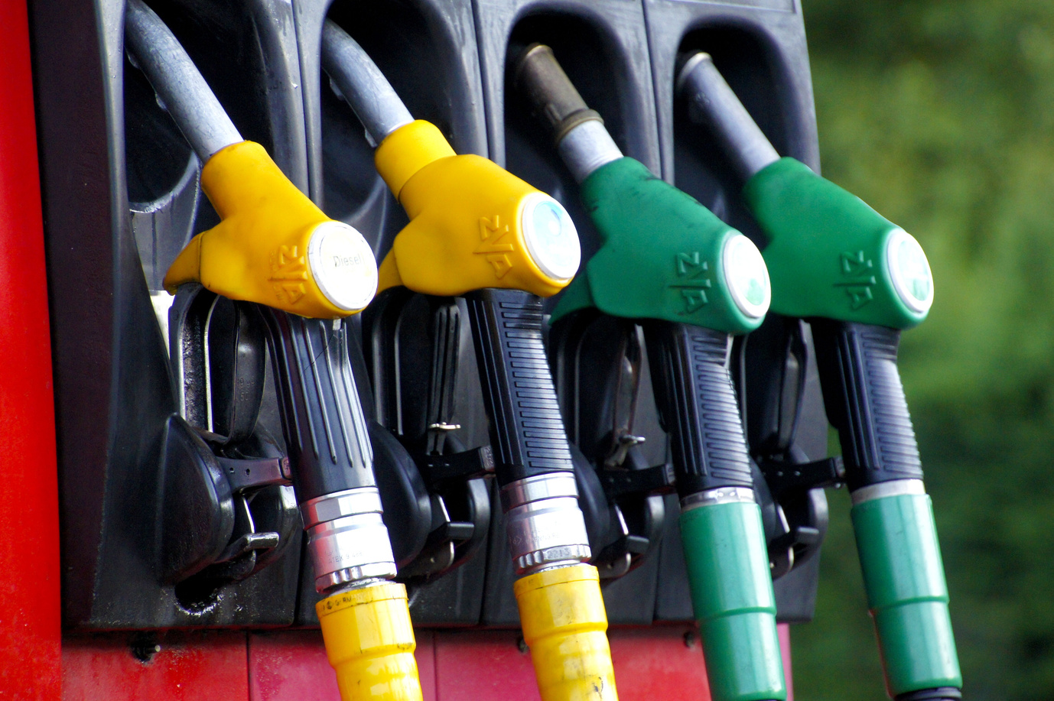
Organic Waste as Alternative Energy – Biogas (Cont.)
To get the desired biogas, the bioreactor (tank) must be anaerobic.
It must not have oxygen and air entering so that organic waste that is put into the bioreactor can be converted by microbes.

Slide 11
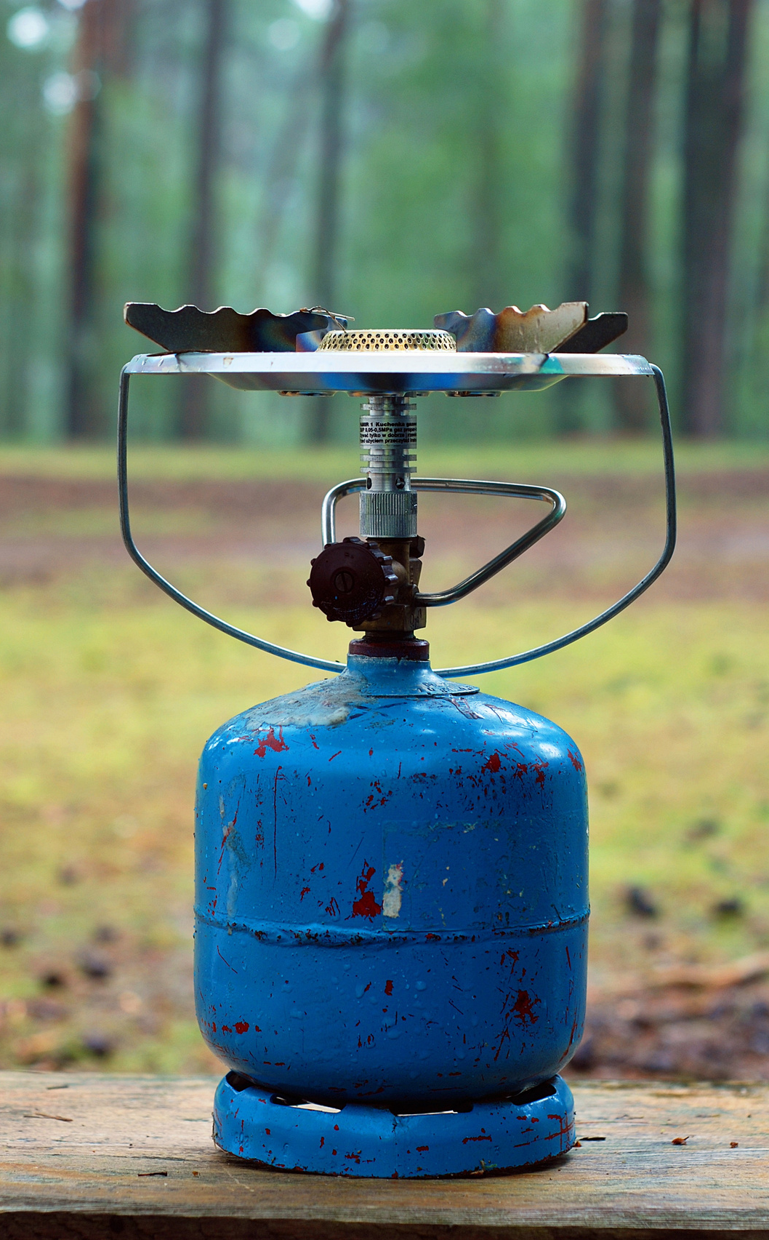
Organic Waste as Alternative Energy – Biogas (Cont.)
On a small scale, household waste produces 1,000 liters of garbage or 300 kg of waste, producing about 50-60 percent of CH4 gas, methane, and carbon dioxide.

Slide 12
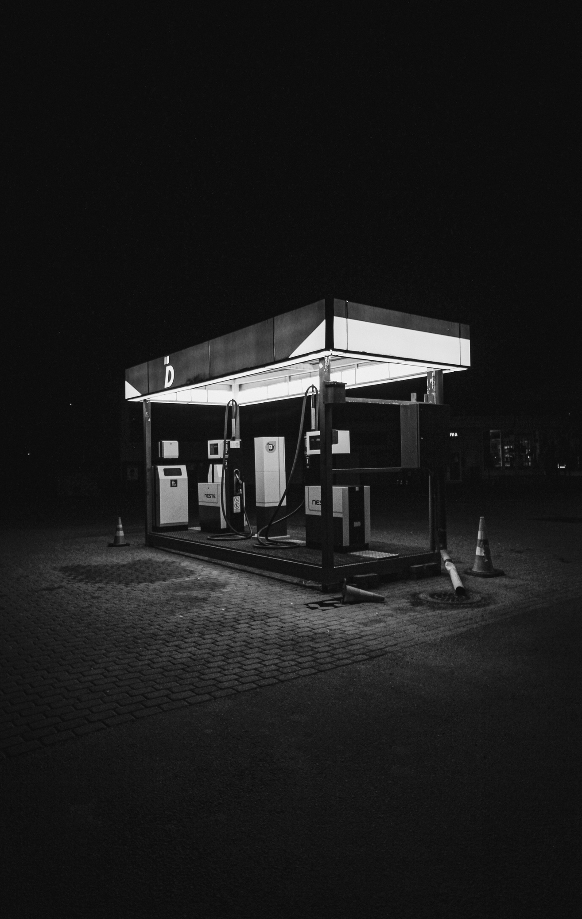
Organic Waste as Alternative Energy – Biogas (Cont.)
100 kg buffalo manure or dung accommodated in the bioreactor produces biogas in less than six days, saving up 6 liters of kerosene a day

Slide 13

Organic Waste as Alternative Energy – Biogas (Cont.)
Waste from bioreactors that cannot be converted is then used for compost – as fertilizer for plants.
The unconverted animal waste in the bioreactor also produces Rubellus Rumbricus earthworms that are helpful in soil fertilization and alternative medicine.

Slide 14

Conclusion
The renewal of alternative energy will support and directly save the environment
These alternative energy sources should be increasingly applied and utilized in our community for the common good and sustainability

Slide 15

thank you

